Slide 1
British Airways
Skytrax Customer Reviews

Slide 2
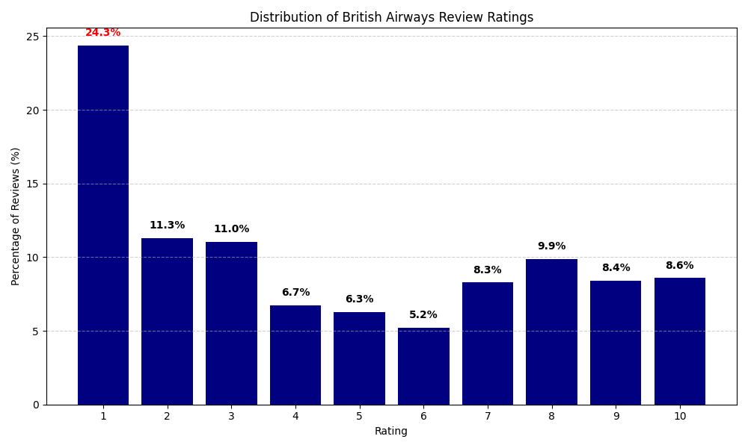
Summary of Review Ratings
There are almost 25% 1-star reviews
Only 8.6% of 3927 reviews are 10-star reviews

